Slide 1
College Enrolement System
Dinesh Singh
Divya Chekuri

Slide 2
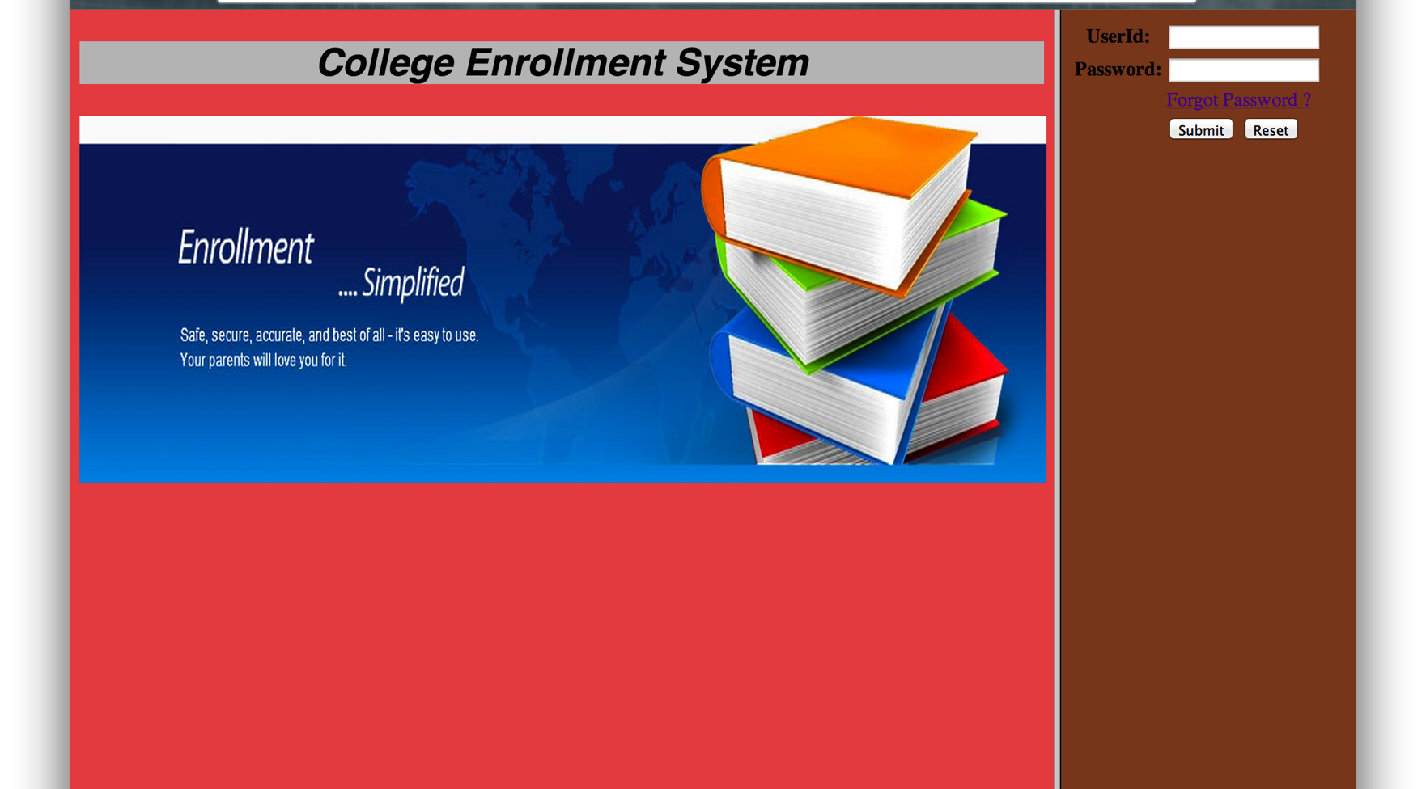
Welcome File
User Id and Password are For Administration use for managing Student Details

Slide 3
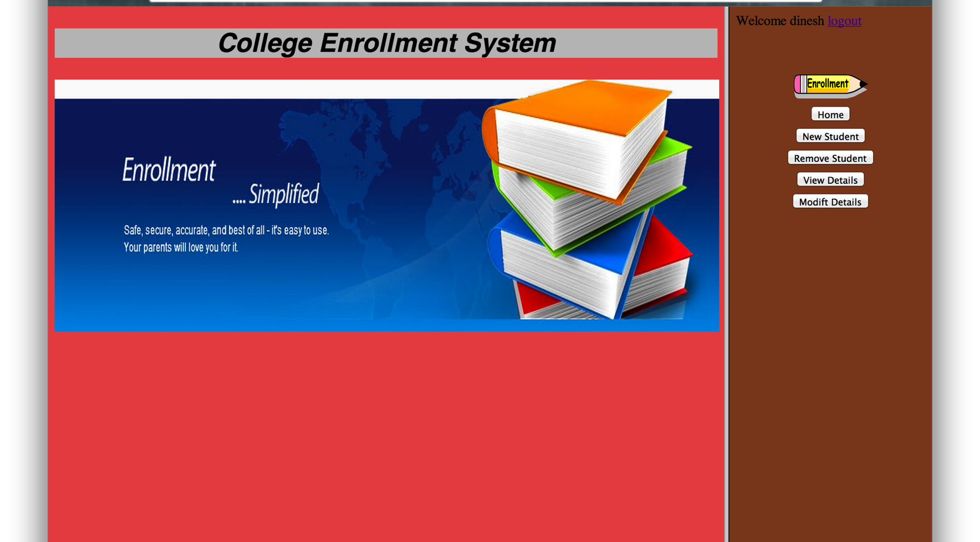
Logged In page
As the Administrator gets logged in, admin gets various options as shown above

Slide 4
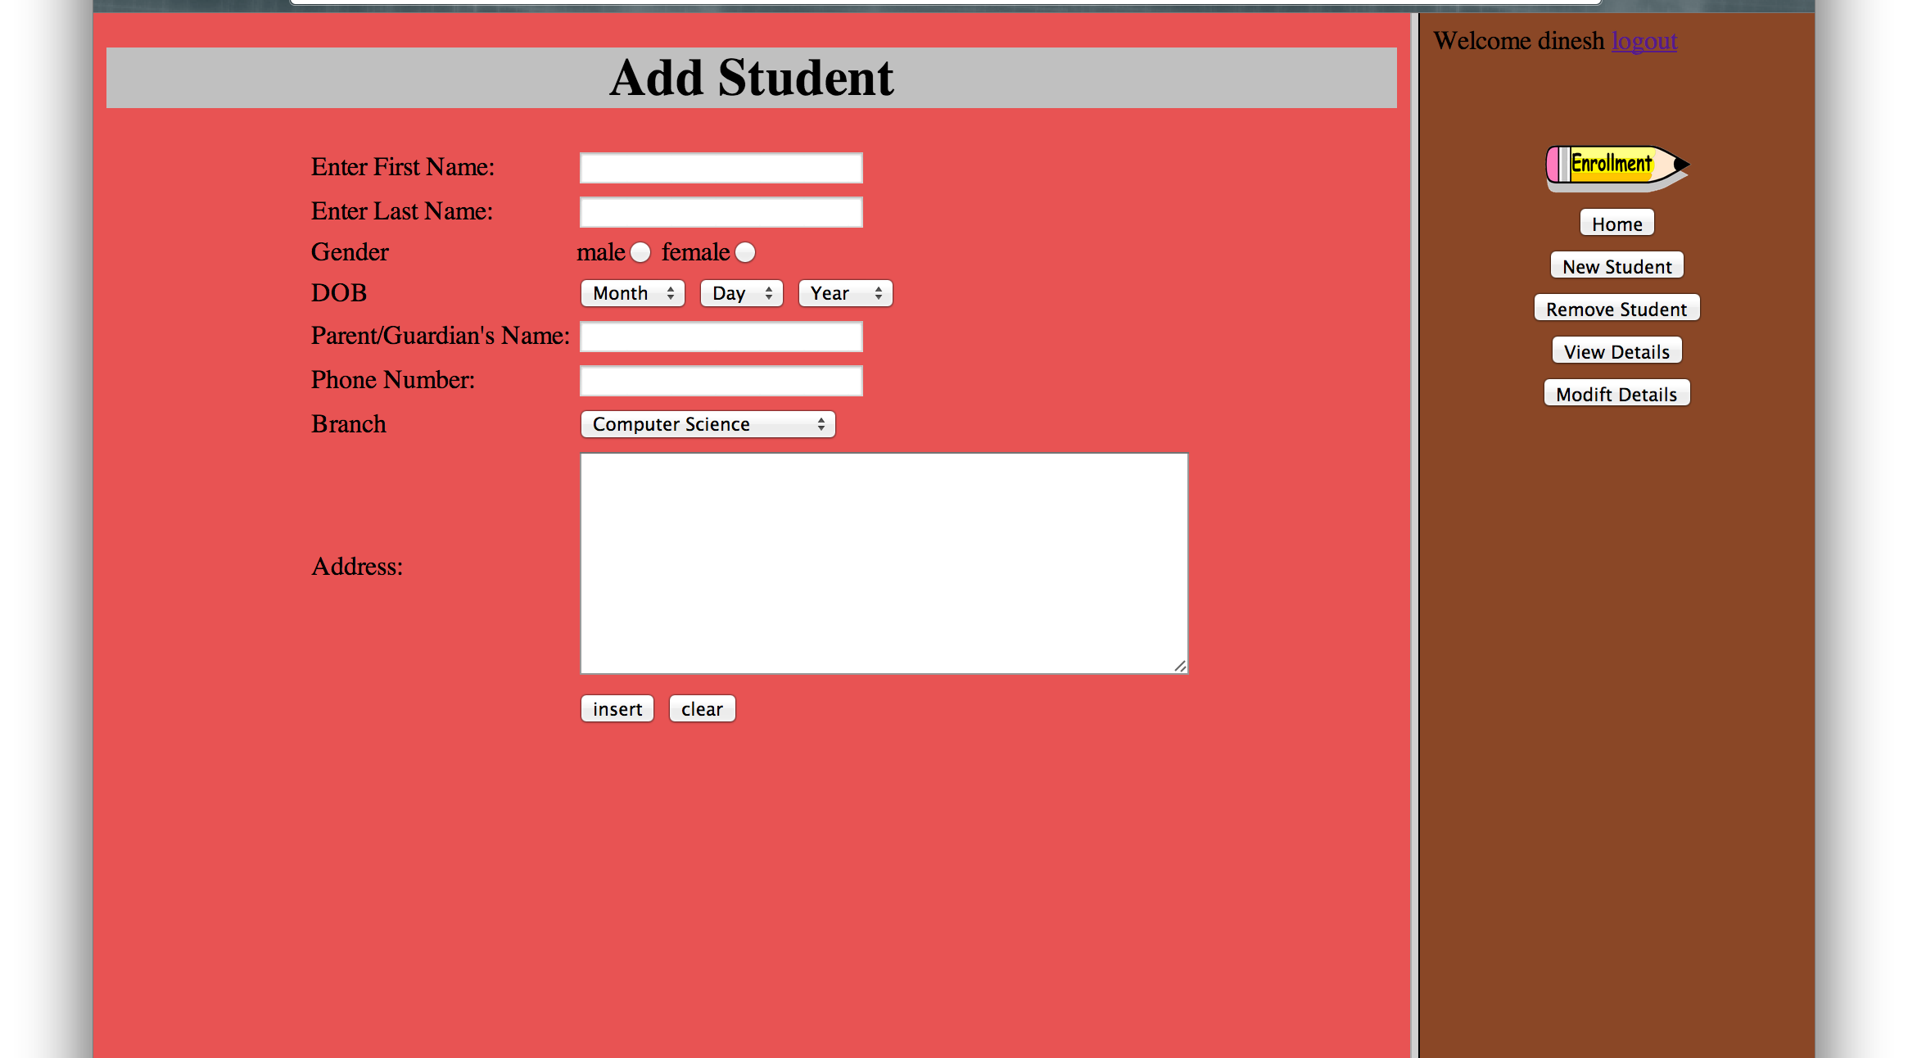
Adding a New Student
Admin can insert an Student as the above

Slide 5
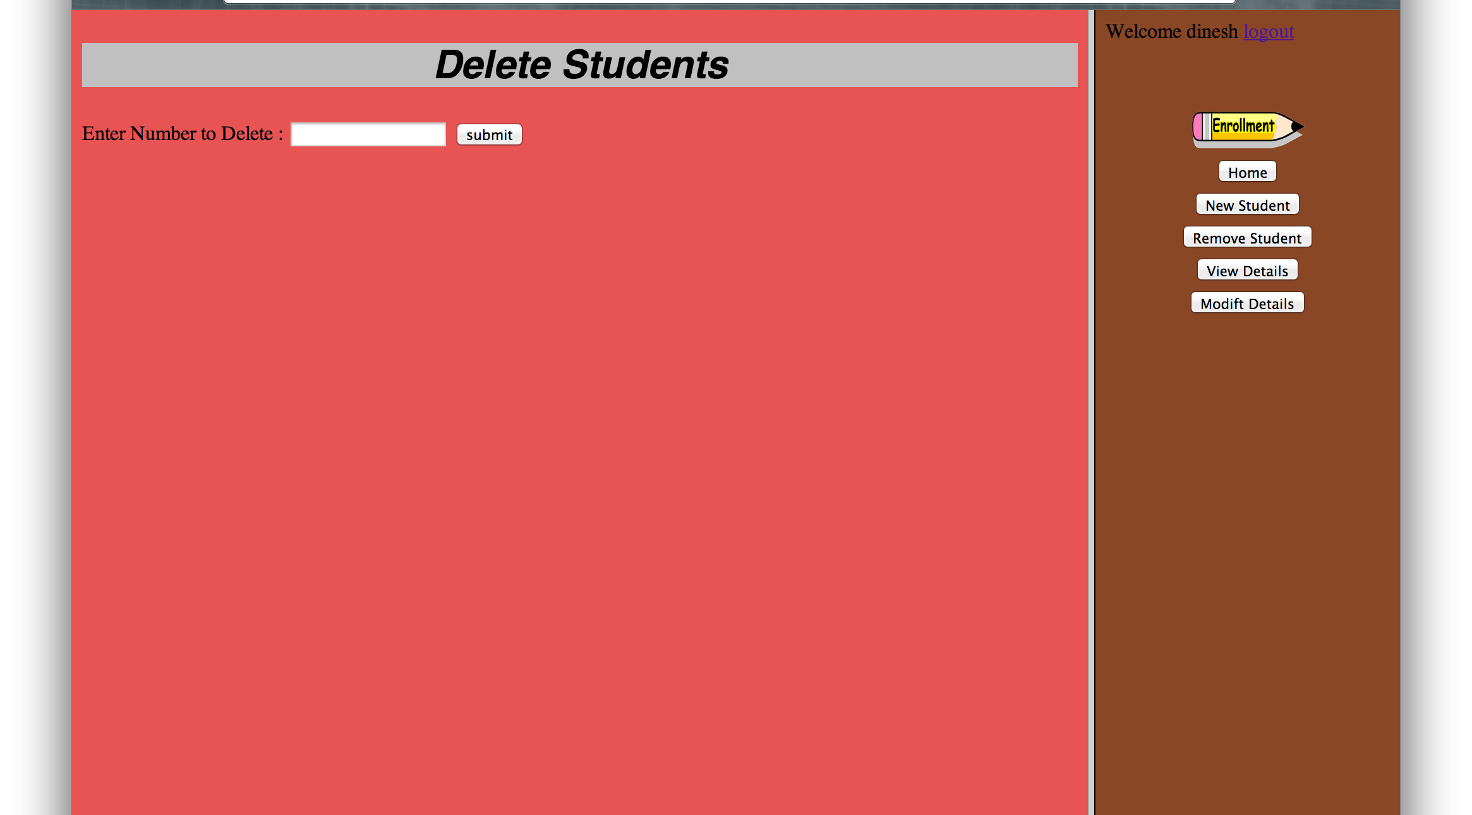
Deleting a Student
Admin can delete Students based on Number(primary key)

Slide 6
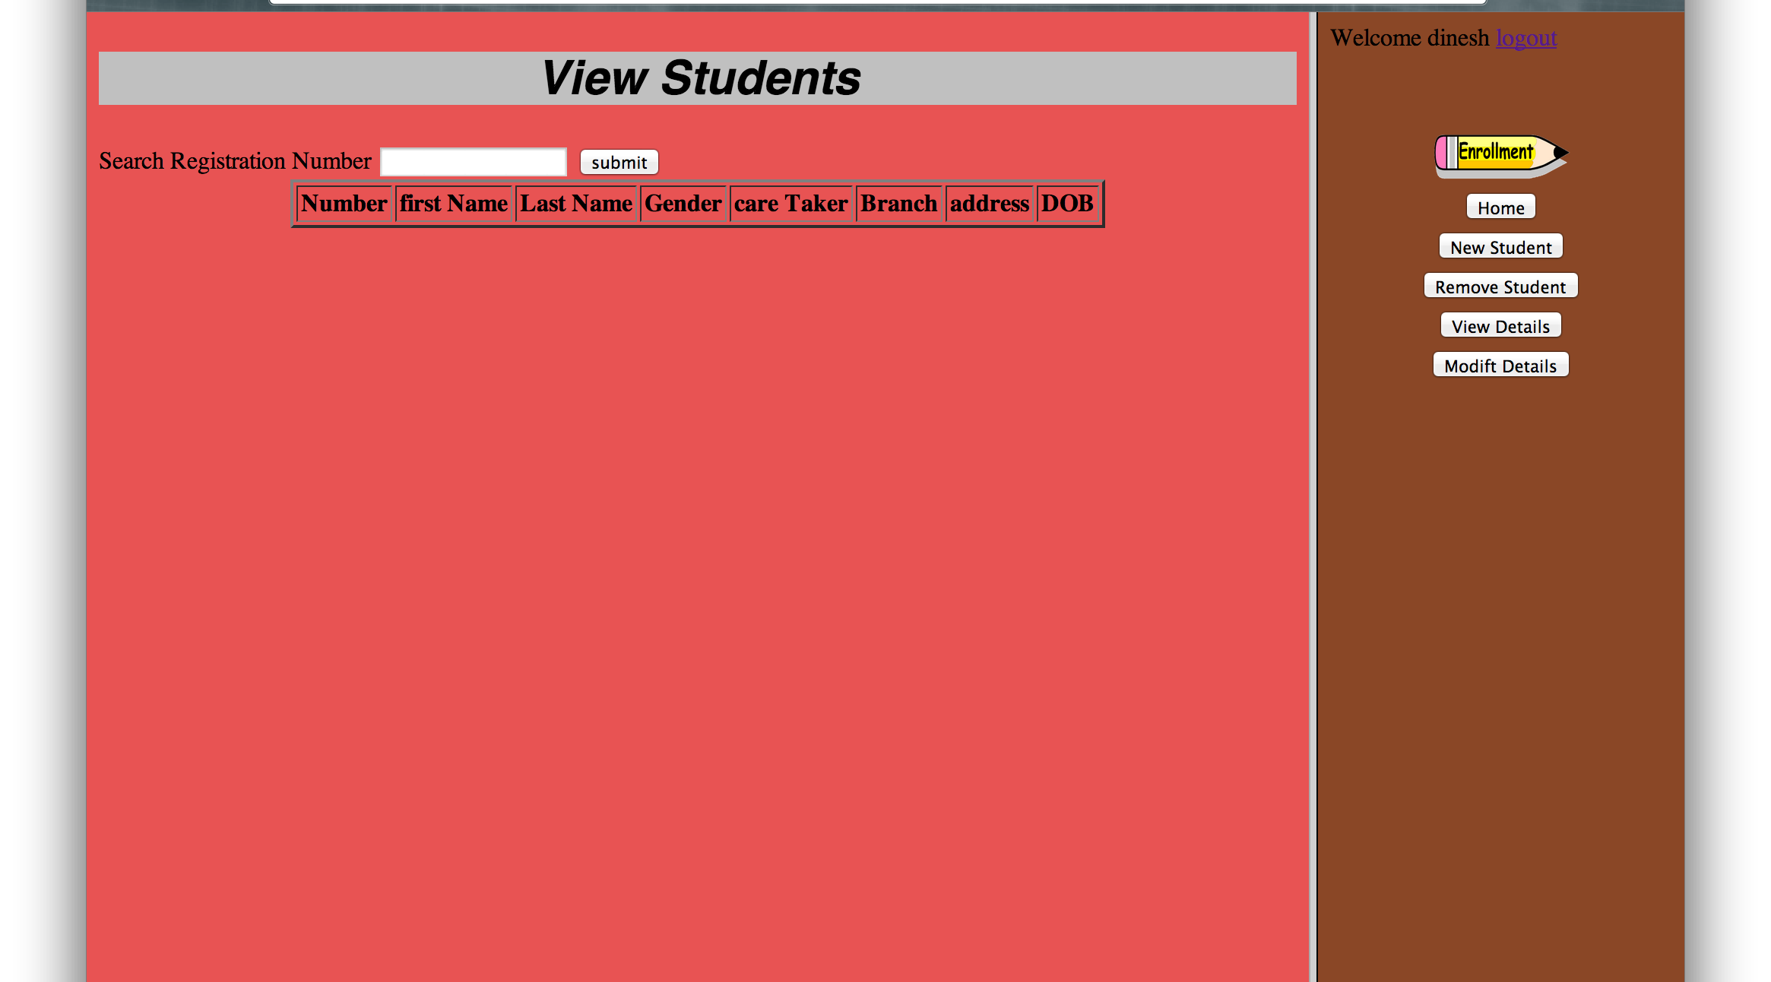
View Students
This page displays all the detials about a all student Admin can also search for the student

Slide 7
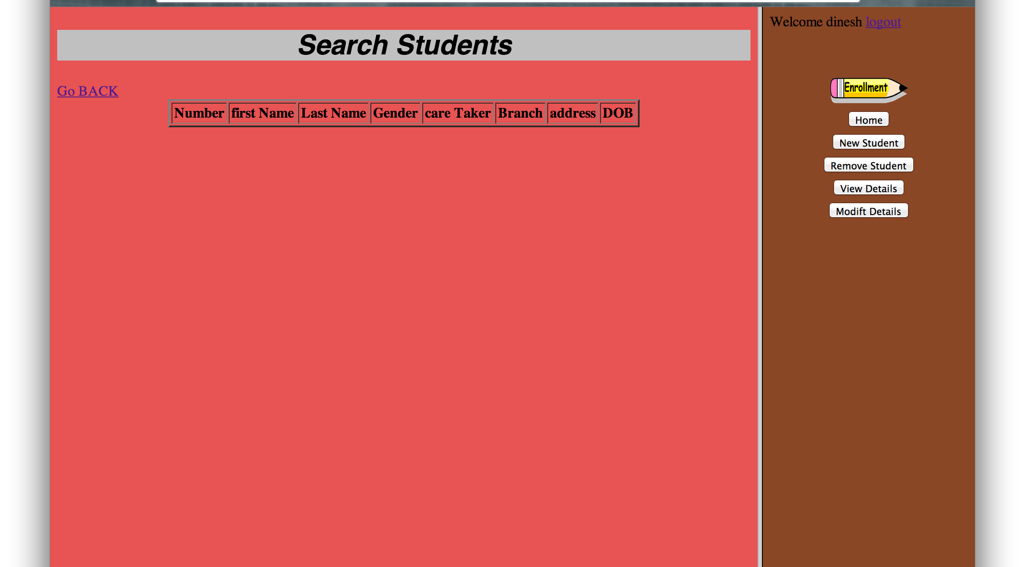
Searching a Student
Admin Searches a Particular student Details from DataBase

Slide 8
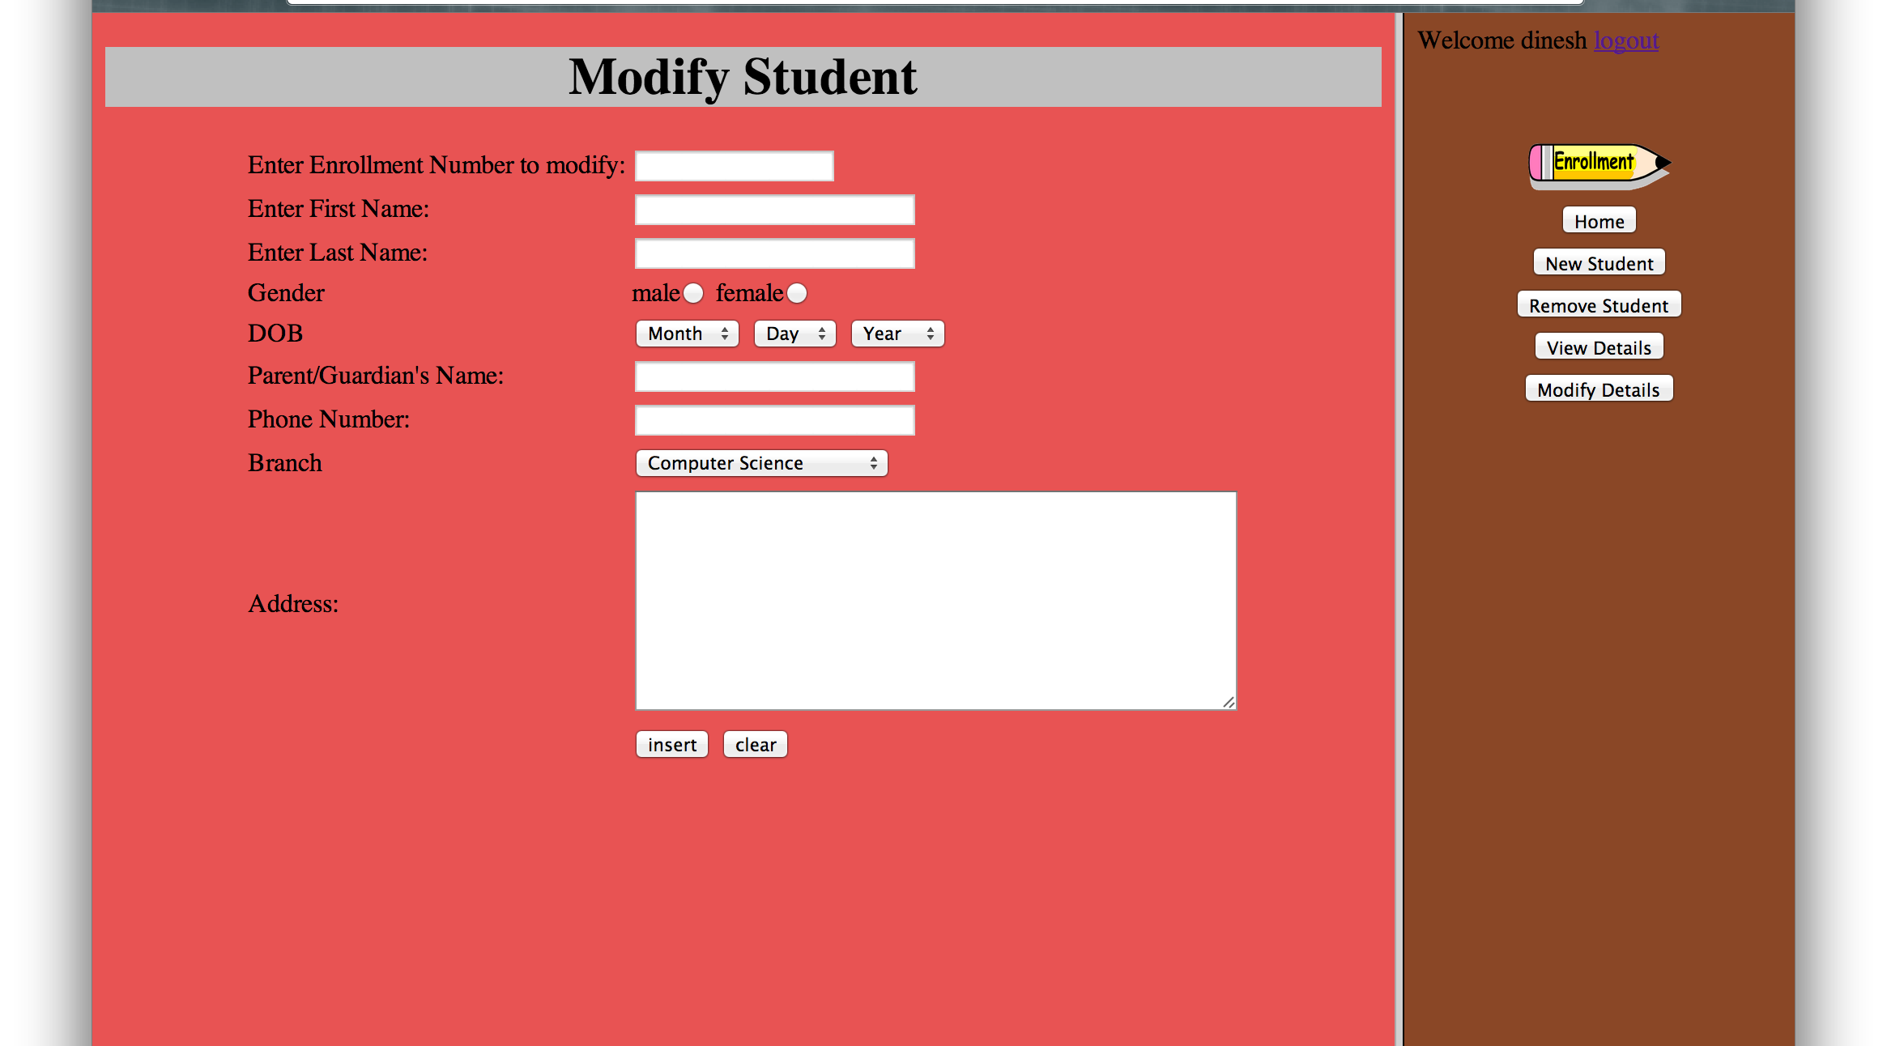
Modifying Details of Students
Admin modifies the Details depending upon the Enrolment Number

Slide 9
After Logging Out
When Admin LogsOut the Home Page gets Displayed

Slide 10
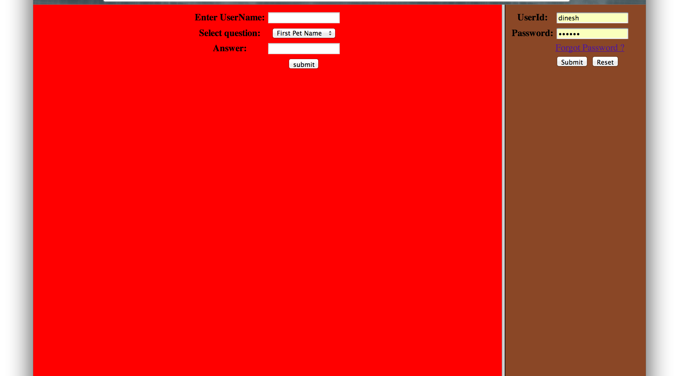
Forgot Password
If Admin Forgets his Login Details he can Retrieve it From here

Slide 11
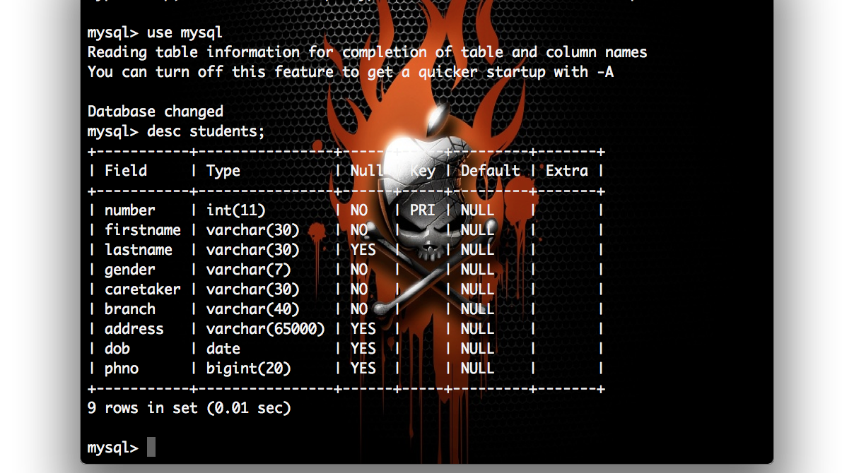
Student Database

Slide 12
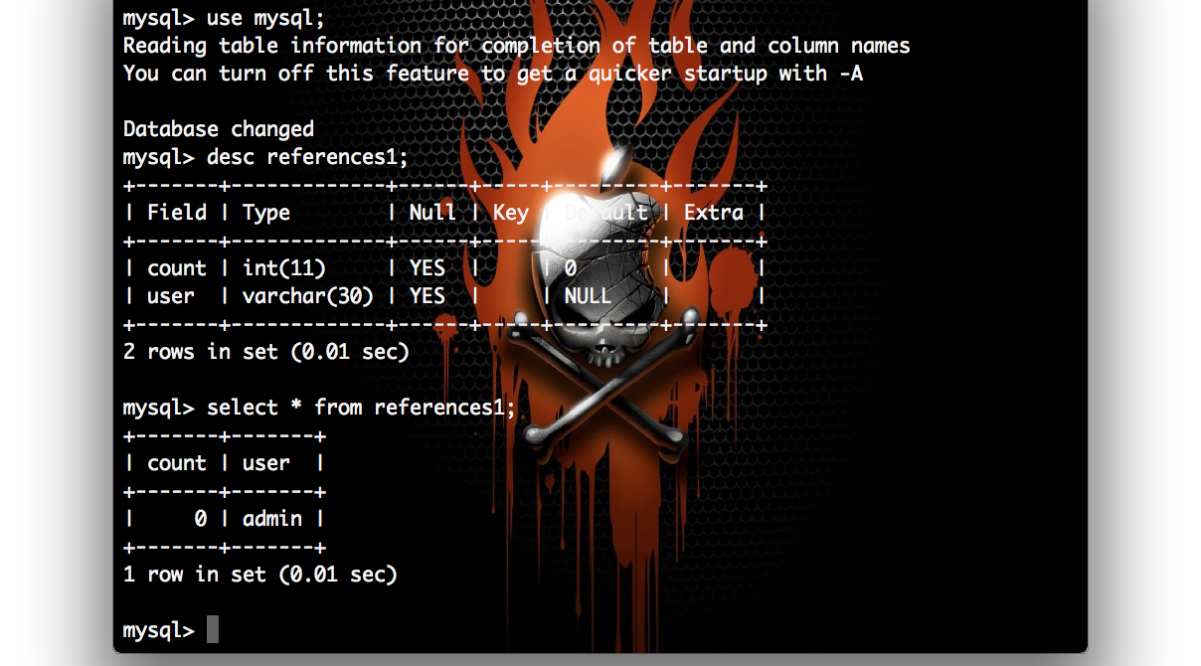
References Database

Slide 13
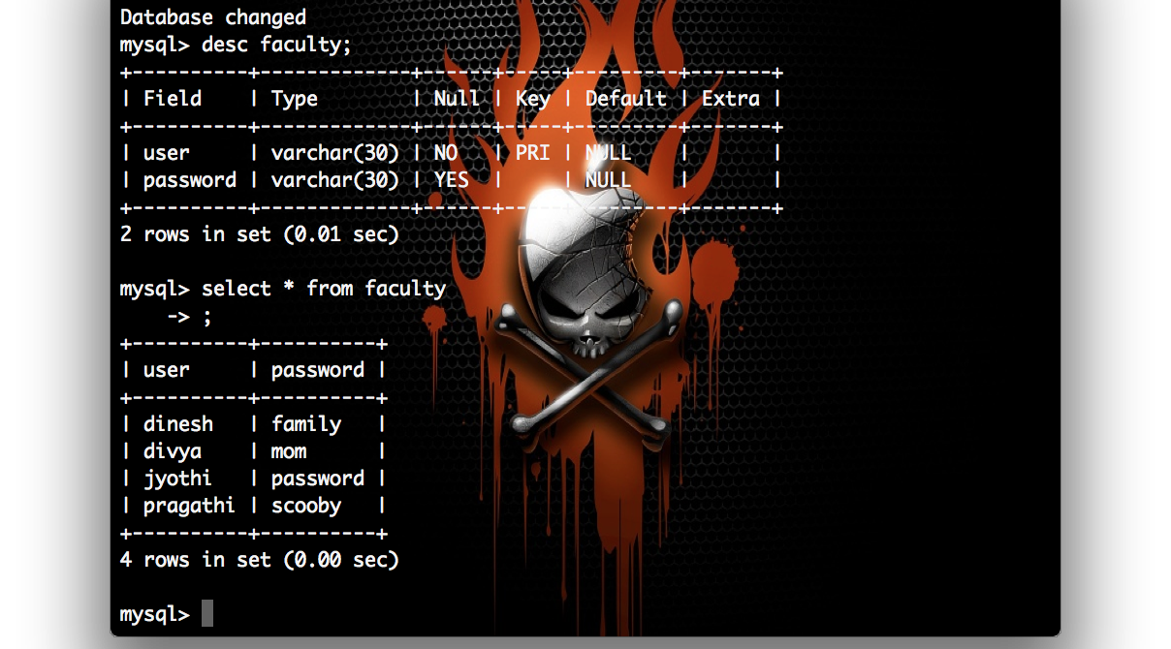
Faculty DataBase

Slide 14
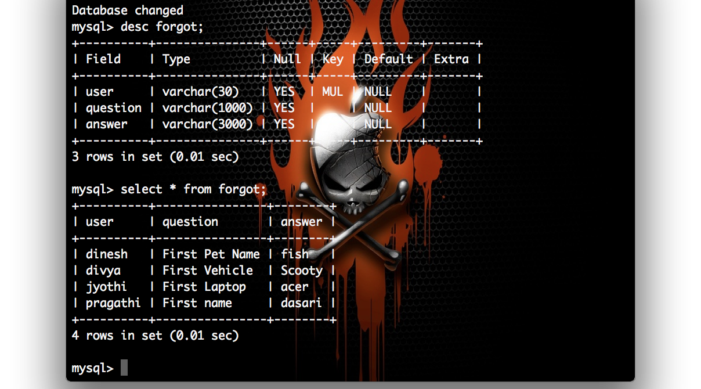
Forgot DataBase

Slide 15
Thank You

